Slide 1


ABAP on Hana s/4 Hana Training
Day 6
contact@anubhavtrainings.com

Slide 2

Agenda – Day 6
Data Modeling
Attribute View
Analytics View
Calculation View
Graphical Calculation Views
Scripted Calculation Views
Classification of Join
Creation and execution of Data Models
Showing Concept of currency conversion
Concept of Dimensions and Measures

Slide 3

HANA Modeling
Lots of data is kept in HANA, we want to utilize processing of data deeper into the database. When HANA was introduced SAP thought, how can we improve the performance by allowing customers and partners to perform code-to-data . The problem of writing optimized SQL code is-
Challenges with ABAP Coding / SQL Queries
Not everyone is so experienced to write optimized SQL query
Sometimes, we do incorrect nesting unknowingly which cause a recurring DB calls
Many colleagues are not from ABAP background with coding skills
Let someone else optimize the queries for us for DB
Easy way to write complex requirements any one can develop w/o much experience
Modeling is a field of Database engineering which allows developers/consultants to build a graphical model w/o getting too much into technical stuff. The system will then compute the model and generate DB objects automatically which are also optimized to get best performance.

Slide 4
Models in SAP HANA
01
Attribute View
02
Analytic View
03
Calculation View

Slide 5
Why 3 Models?
Processed inside JOIN engine
Is to read master data and joins must faster than any other views
We must mark key field while developing attribute views
Add calculations also
5 types of Joins
01
Most powerful view type
Multi purpose, read any source table, other view
Processed in calculation engine
Have lots of build in functions
2 Types of Calculation Views :
Graphical
Scripted
Attribute View.
03
Analytic View
Processed inside OLAP/Analytic engine
Is to read combination of transaction and master data
Good performing Aggregations like SUM, MIN, MAX, COUNT, AVG
Perform Currency conversion
Run Analytics on top
Calculation View.
02
https://archive.sap.com/documents/docs/DOC-73509#:~:text=For%20all%20other%20cases%20Analytical,foundation%20node%20allows%20views%2Ftables.

Slide 7
Measures and dimensions
Master data – does not change frequently
Dimension
Customer | Name
C1 | SAP
C2 | IBM
C3 | Apple
PID | Product
P1 | Laptop
P2 | Webcam
P3 | Projectors
Transaction data (facts) – KPI – Key Performance Indicator – Numbers
Defining a measure (help us measuring performance)
SAP 250+800 = 1050
IBM = 1200
Apple = 1200
SO_ID | Customer | Amount | Currency | EMP_ID | PROD | Country
1 | C1 | 250 | USD | 1001 | P1 | US
2 | C2 | 600 | USD | 1002 | P2 | US
3 | C1 | 800 | EUR | 1001 | P2 | EU
4 | C2 | 600 | USD | 1001 | P3 | US
5 | C3 | 1200 | USD | 1002 | P1 | EU
Total sales, total sales by currency
EMPID | Name
1001 | Saurabh
1002 | Ananya
1003 | Anubhav
TIME
Year, Quarter, Month,

Slide 8








Joins in HANA
03
Right Outer join
04
Temporal join
08
Referential join
08
07
Text join
03
05
07
04
02
06
02
Left Outer join
01
05
Spatial join
01
Inner join
06
Star join

Slide 9
Classification of Joins in HANA
Inner join- Intersection of two tables, fetch exact matching column data from joined tables.
Left outer Join – will fetch intersection + extra data from left table which has no matching records in right table
Right Outer Join – will fetch intersection + extra data from right table which has no matching records on left side
Temporal Join – This join enables a join with TIME dimension, in HANA there are M* tables which represent time dimension.
Spatial Join – Join geo stationary coordinate to calculate distances, locations, area, ..
Star Join – When we have more than one analytic views to be joined, we use star join.
Text Join – Text always used to join text tables, which has language specific description. System automatically pass the current login language to the join and text table. We need to mark language column while doing this join.
A
B
A
B
A
B

Slide 10
Classification of Joins in HANA
8. Referential Join – Is a smart INNER JOIN. The join will be executed as inner join when columns from both tables are
selected in the query. But when the query has selected ONLY columns from one of the table alone, the join will be pruned (abandoned/ignored)
BookingID | Date
10001 | 01.03.2021
10002 | 02.04.2021
10003 | 03.04.2021
FlightDate | Airline
01.03.2021 | FedEX
02.04.2021 | DHL
04.04.2021 | FFFL
HANA View – AT_FF
Inner join
Q1 - SELECT bookingId, Airline From AT_FF
FedEx
DHL
Q2 – Select BookingID from AT_FF;
10001
10002
JOIN is BOUND to HAPPED
Referential join
Q1 - SELECT bookingId, Airline From AT_FF --inner join
FedEx
DHL
Q2 – Select BookingID from AT_FF; --pruned
10001
10002
10003

Slide 11
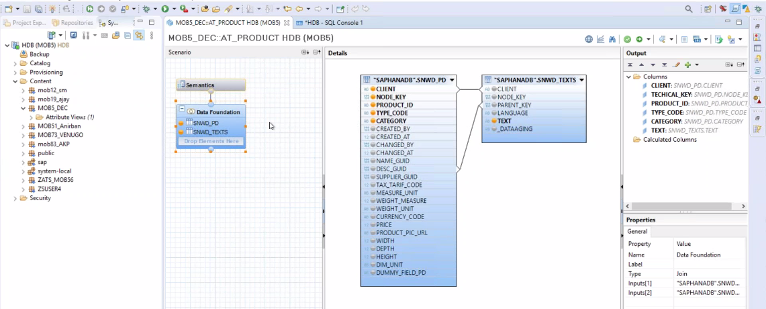
Attribute View
Attribute views provide descriptive data about the characteristics of data in your database. This is “master data” that defines things like hierarchies that describe relationships between data elements. By constructing attribute views, you create dimensions from which subsequent views can be constructed.

Slide 12
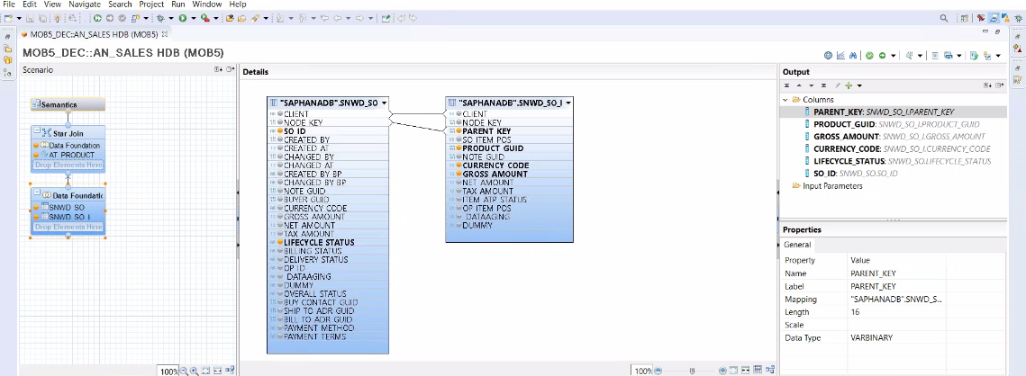
Analytic View
Analytic views in SAP HANA are optimized for aggregating mass data. Because the database is so fast, it’s not necessary to store aggregates in the database; rather, you aggregate on the fly in memory. Analytic views construct a central master “fact table” with key figures. You can use expressions, operators, and functions to analyze this data.

Slide 13

End of Day 6
Trainer: Anubhav Oberoy & Shubham Singh

Slide 14

Trainer: Anubhav Oberoy & Shubham Singh

Slide 15
THANK YOU
If you cannot do
great things, do small things in a great way.
Anubhav Oberoy & Shubham Singh
https://www.anubhavtrainings.com

Slide 16


We’re committed to empower you to be
Most Desirable Resource
through powerful training solutions.
We build the workforce of the future.
250+
Corporate Clients
30,000+
Learners Trained
25000+
Learners Placed
FREE WEBINARS
Sign up for free webinars with industry experts every fortnight!
Enroll Now!
Contact us today!
https://anubhavtrainings.com/

Slide 17




More from AnubhavTrainings.com

